Slide 1

General Functions

Slide 2
What are General Functions?
The General Functions work with any data type and pertain to using nulls.
These functions include:
  NVL (expr1, expr2)
  NVL2 (expr1, expr2, expr3)
  NULLIF (expr1, expr2)
  COALESCE(expr1, expr2, … , expression)

Slide 3
NVL Function
NVL function is used to convert a null value in a column of any datatype into an actual value for display purposes.
Syntax: NVL(expr1,expr2)
The NVL function has two arguments:
  expr1 is the source value or expression that may contain NULL, and
  expr2 is the target value or the result.

Slide 4
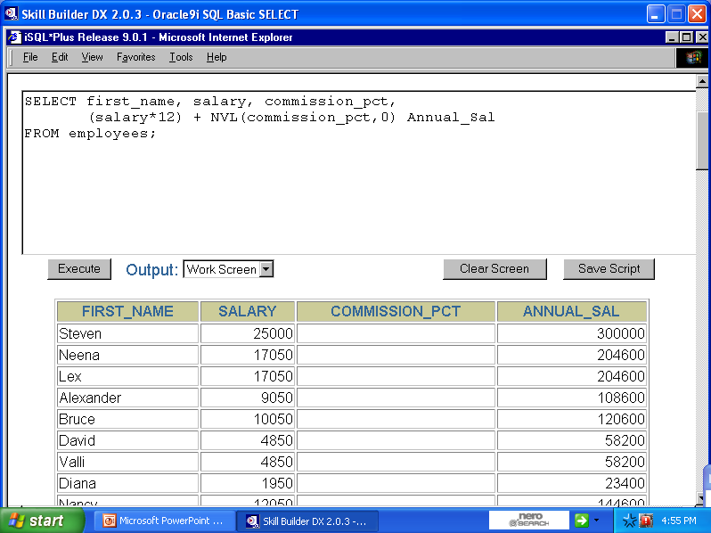

Slide 5
NVL2 Functions
Syntax: NVL2(expr1,expr2,expr3)
The NVL2 function is used to evaluate whether a column is null and return a value based on the result.
The NVL2 function accepts three arguments.
The function initially examines the first expression.
If expr1 is not null, the NVL2 function returns expr2.
If expr1 is null, the NVL2 function returns expr3.

Slide 6
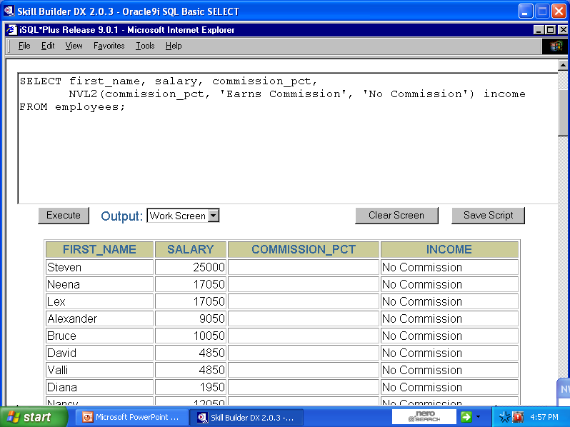

Slide 7
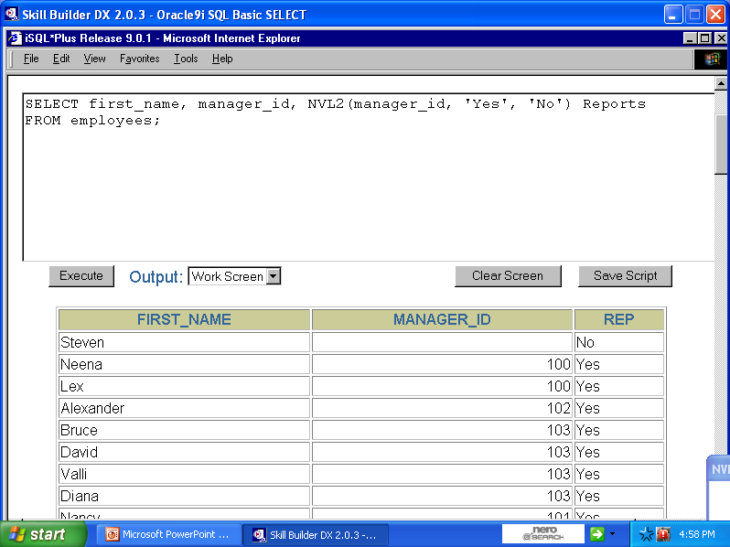

Slide 8
NULLIF Functions
Syntax: NULLIF(expr1,expr2)
The NULLIF function compares expr1 and expr2.
When both the expressions are equal, the function returns NULL
If the expressions are not equal, the function returns expr1.
*NOTE: expr1 cannot be NULL

Slide 9
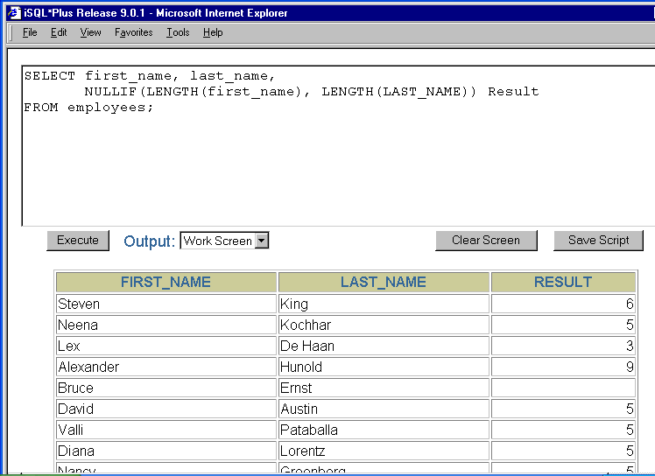

Slide 10
COALESCE Function
Syntax: COALESCE(expr1,expr2,….,exprN)
The COALESCE function returns the first non-NULL expression in a list.
If the first expression is not null, the function returns that expression. Otherwise the function does a COALESCE of the remaining expressions.
The last expression is returned if all the preceding expressions are NULL.

Slide 11
